Slide 1
Git & github

Slide 2
Version Control
Version control is a system that records changes to a file or set of files over time so that you can recall specific versions later.
Version control allows you to revert selected files back to a previous state, revert the entire project back to a previous state, compare changes over time, see who last modified something that might be causing a problem, who introduced an issue and when, and more.

Slide 3
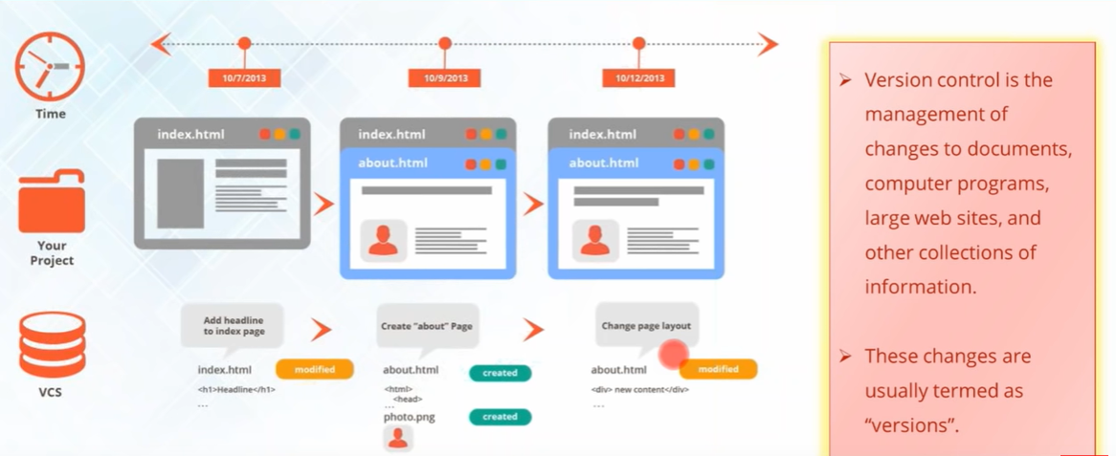
Version Control

Slide 4
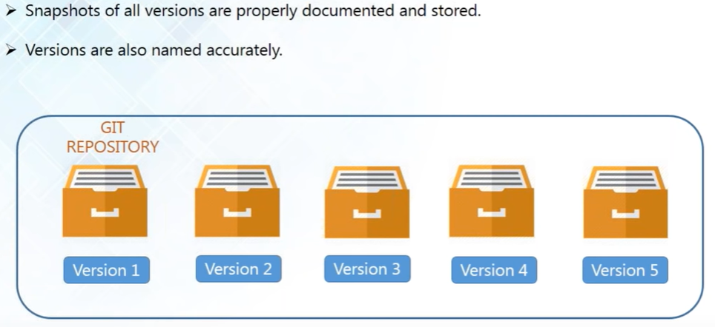
Version Control

Slide 5
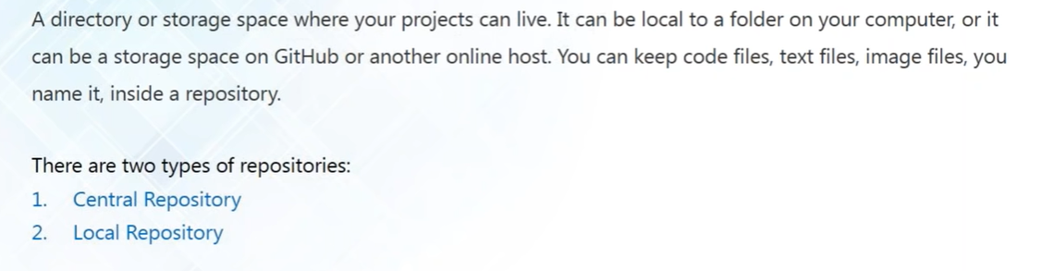
What is repository

Slide 6
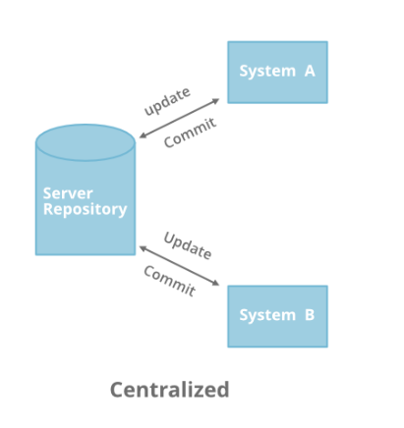
Centralized version control system
Centralized version control system is that it works on a Client-Server relationship. The repository is located at one place and provides access to many clients.

Slide 7
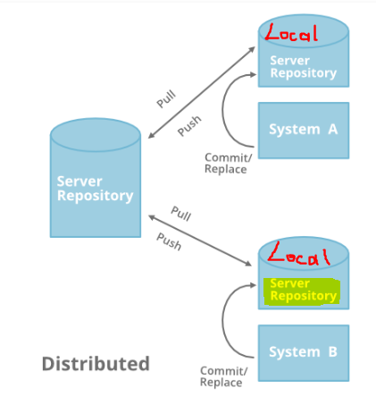
Distributed version control system
In distributed version control systems, every user has a local copy of the repository in addition to the central repository on the server side.
Basically, every user can work locally and disconnected which is more convenient than centralized source control.
Distributed VCS is faster than Centralized VCS because you don’t need to communicate with the remote server for each and every command.
If the main server goes down or it crashes in DVCS, you can still get the backup or entire history of the code from your local repository where the full revision of the code is already saved. This is not in case of CVCS
It doesn’t follow the way of communicating or merging the code straight forward to the master repository after making changes. Firstly you commit all the changes in your own server or repository and then the ‘set of changes’ will merge to the master repository.

Slide 8
Source code
Source code is a collection of statements and instructions that are written by a computer programmer using standard programming languages. Source codes are readable to humans, but must be translated into machine language, or object code, through a compiler.

Slide 9
What is git
Git is a distributed version-control system for tracking changes in source code during software development.
It is designed for coordinating work among programmers, but it can be used to track changes in any set of files.
Its goals include speed, data integrity, and support for distributed, non-linear development workflows.

Slide 10
Features of git
Git supports non-linear development of a software by using branching
Branching helps us always keep the production quality codes on the master branch while working on the branches for changes without updating the master branch code.
When a branch changes ready and at the production quality, they can be merged to the master branch in seconds.
This feature is what it stands GIT apart from other version control systems
All the data in the local repository is compressed and does not take too much space
Fetching data from local repository is a lot faster than getting it from remote repository
If the main server goes down or it crashes, you can still get the backup or entire history of the code from your local repository

Slide 11
GIT operations and commands

Slide 12
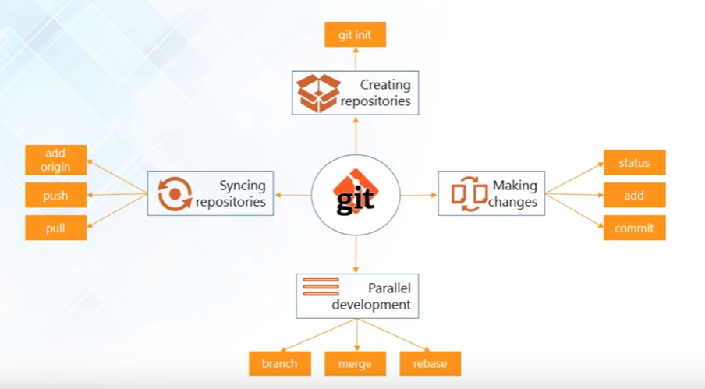
GIT operations and commands

Slide 13
Let’s create our remote(github) and local repositories in order to practice git commands

Slide 14
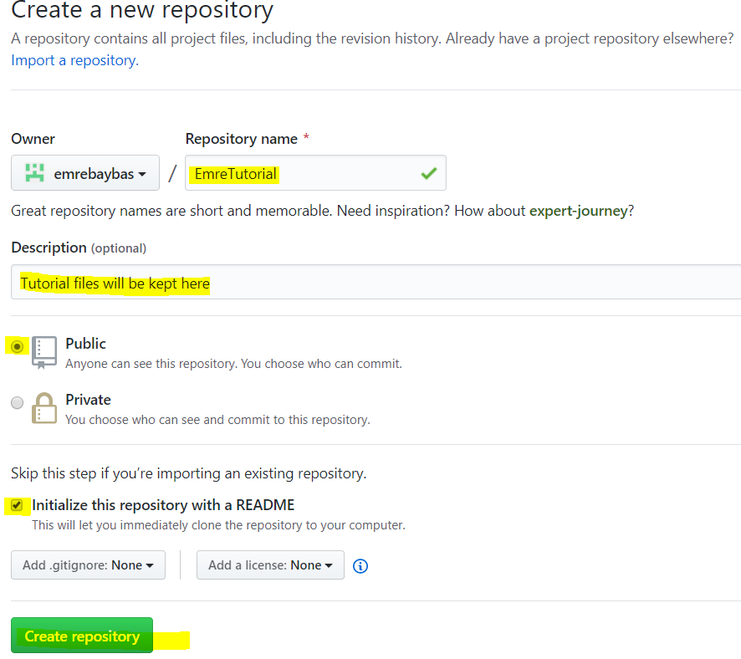
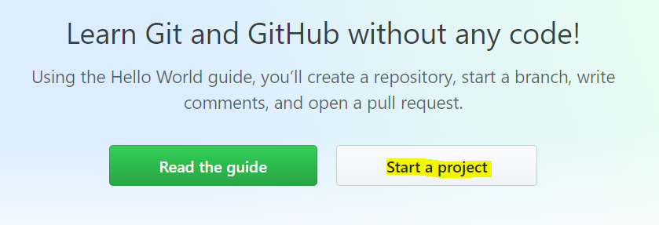
Lets create a github account and a repository

Slide 15
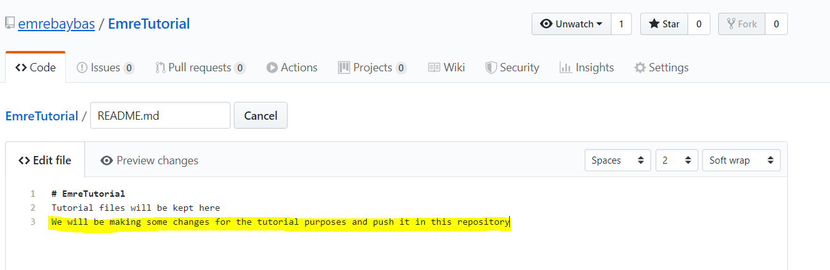
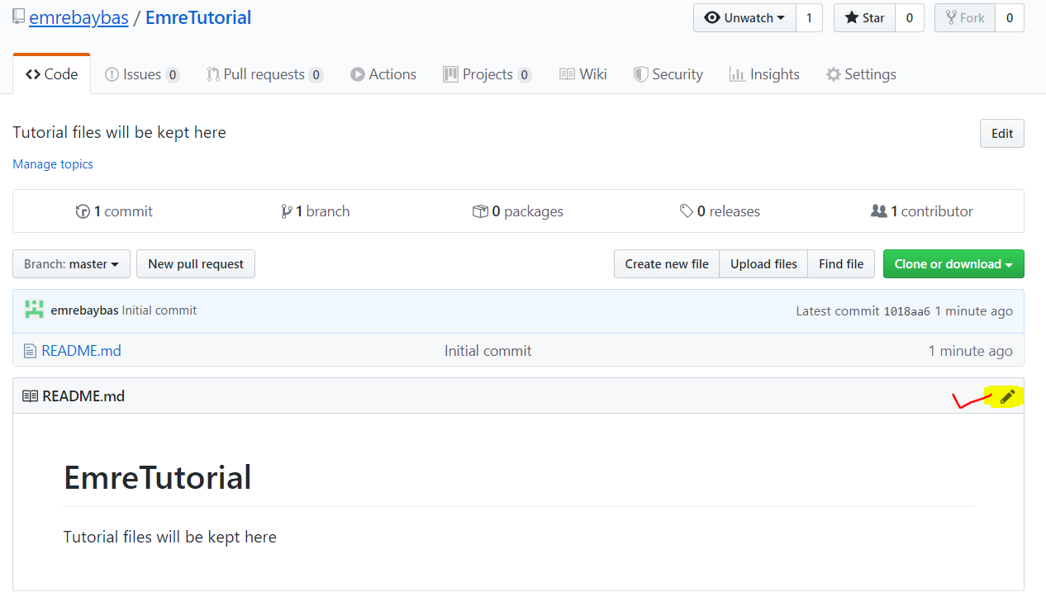
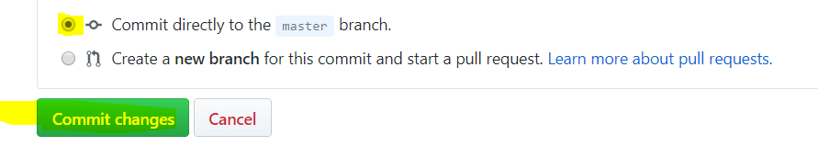
Github Repository
You can click on README.md and enter a description and update it

Slide 16
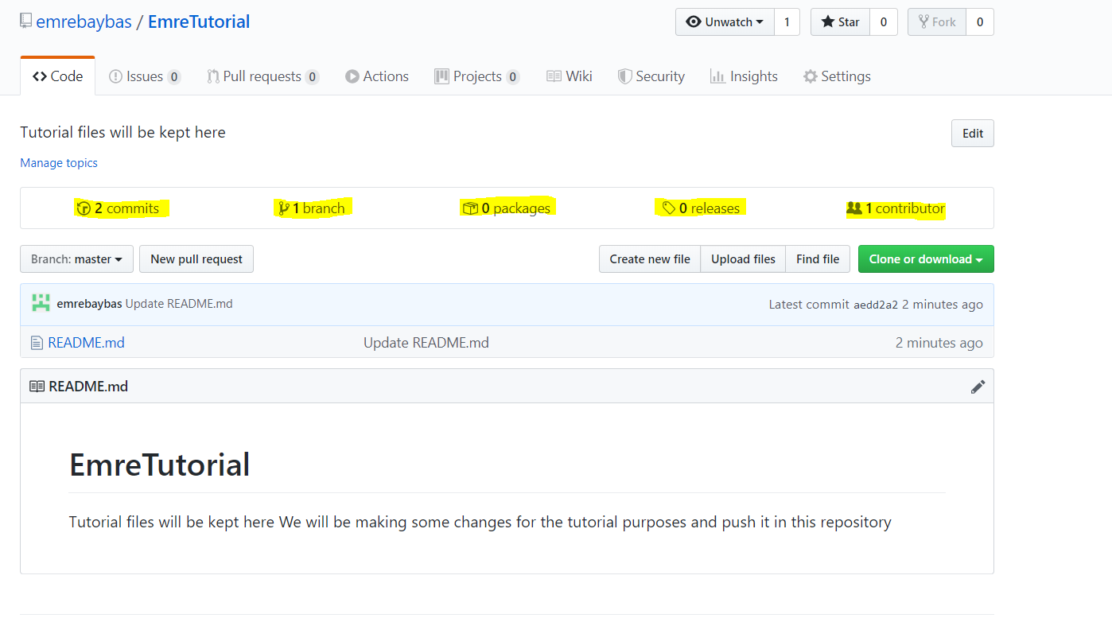
We can view
How many commits done
How many branches there are
How many packages
How many releases
How many contributors in the repository

Slide 17
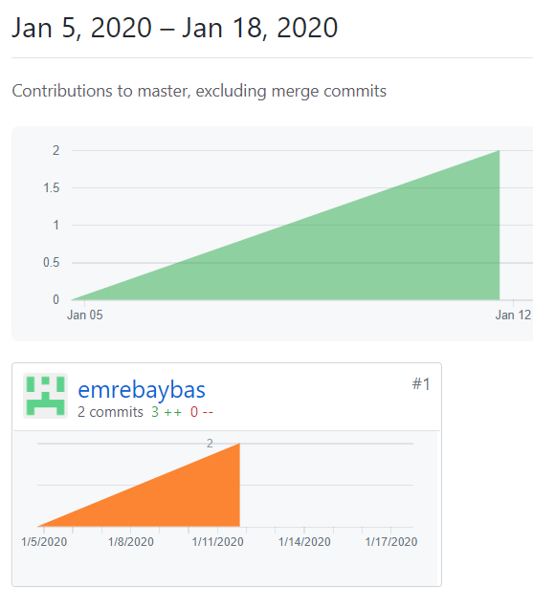
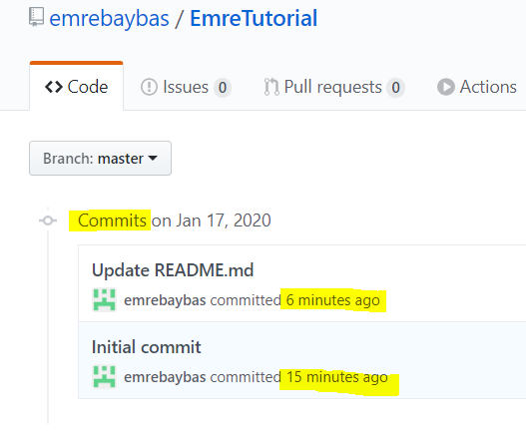
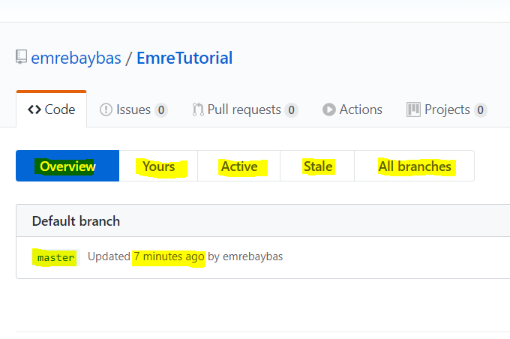
View details by clicking on them

Slide 18
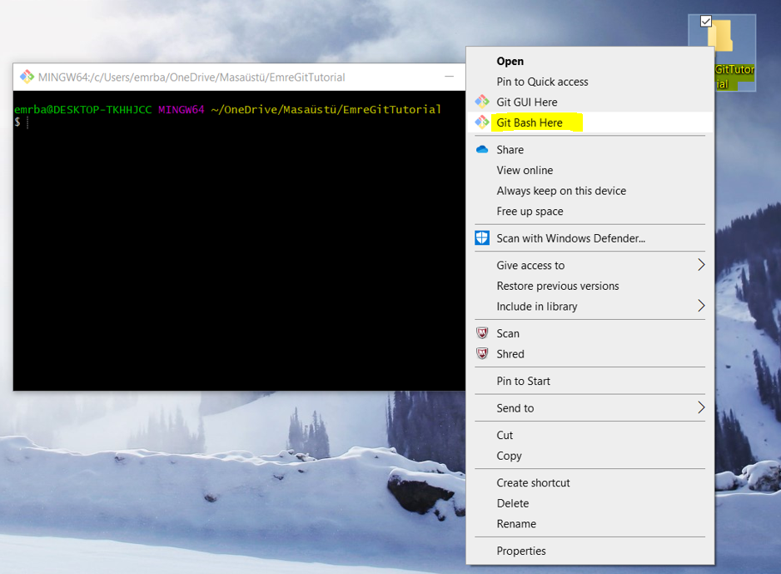
Creating a local repository
Create a folder EmreGitTutorial
Right click → Git Bash Here

Slide 19
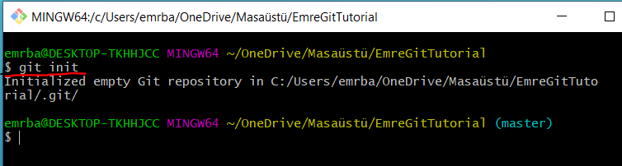
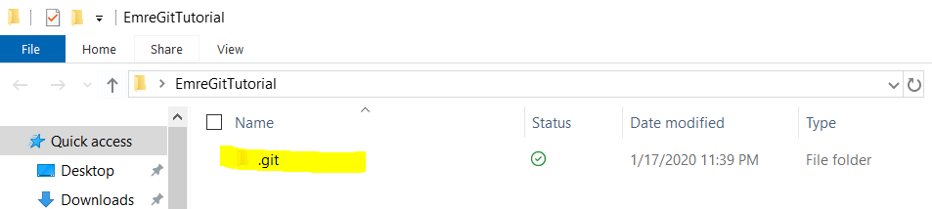
$ git init
‘$ git init’ is used to initialize the local repository from working directory

Slide 20
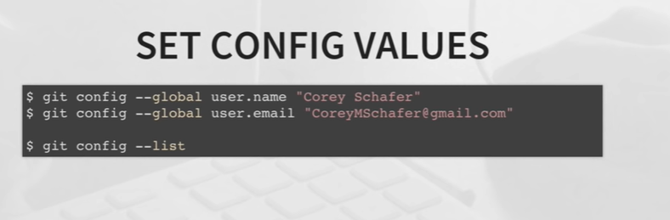

Slide 21
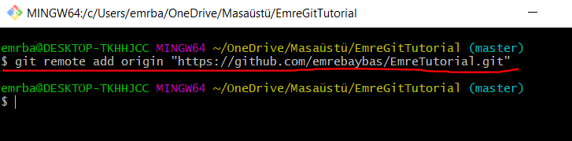
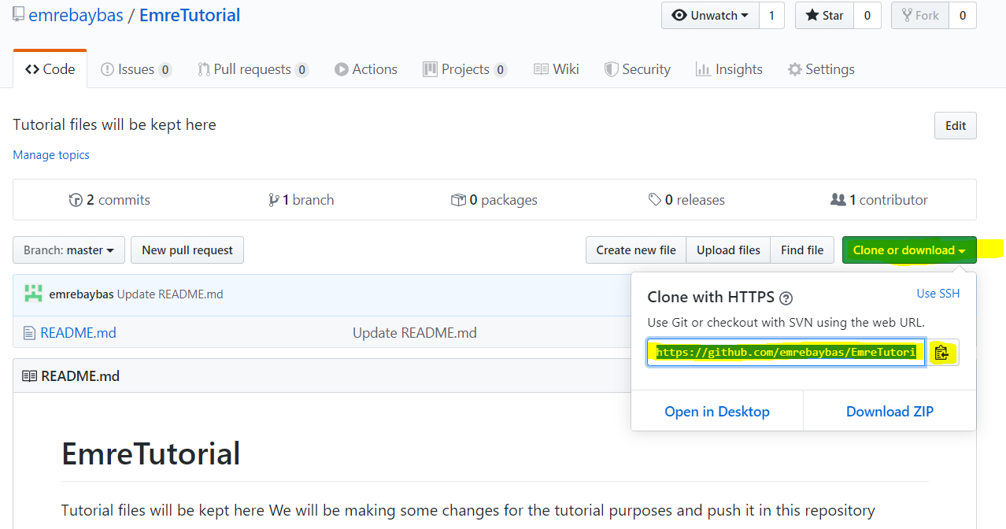
$ git remote add origin “link“
$ git remote add origin “link“ is used to link your local repository to your remote(GITHUB) repository

Slide 22
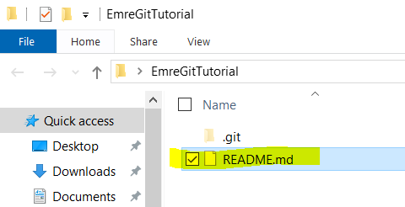
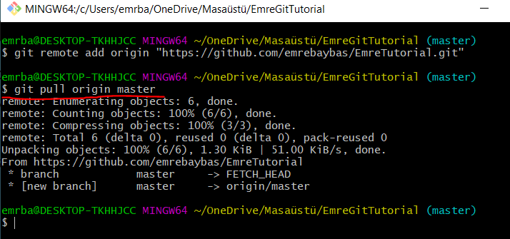
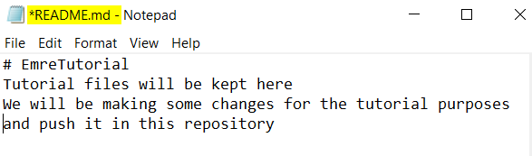
$ git pull
Now we connected our repositories with $ git remote add origin
Let’s pull our README.md file from GITHUB Repository to Local Repository
$ git pull origin master

Slide 23
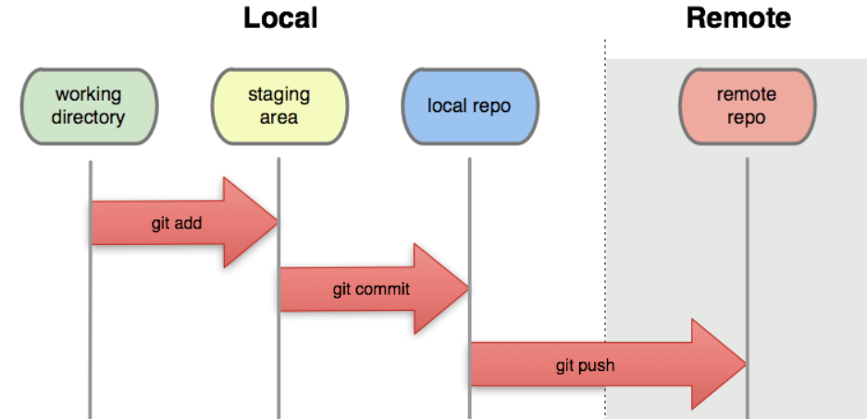
$ git push
$ git status displays the state of the working directory and the staging area.
Shows which changes staged,
which haven't and
which files aren't being tracked by Git.
$ git add * is used to add all the files to staging area
$ git commit –m “my first commit “ is used to save your changes to the local repository.
$ git push –u origin master is used to save the changes to remote(GitHub) repository

Slide 24
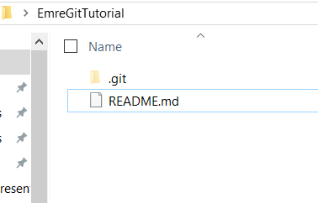
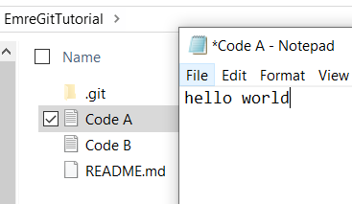
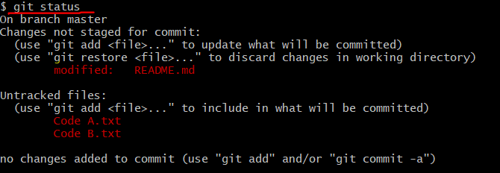
Let’s make some changes in our local repository and push them to our GitHub repository
Shows modifications and creation of new files that needs to be added to staging area
Lets add them

Slide 25
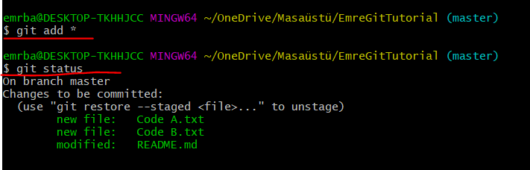
$ git add * or $ git add -A
All the changes are staged and ready to commit

Slide 26
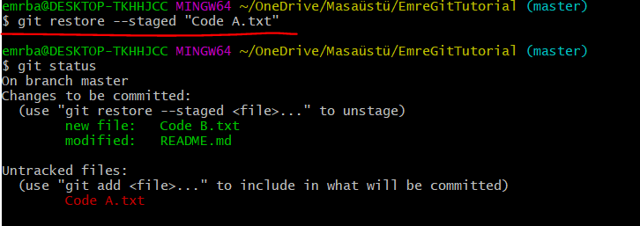
$ git restore --staged “FileName“
Lets say we don’t actually want to save the changes in Code A.txt file
We use $ git restore --staged “Code A.txt “ to Unstage
As we can see Code A.txt is unstaged

Slide 27
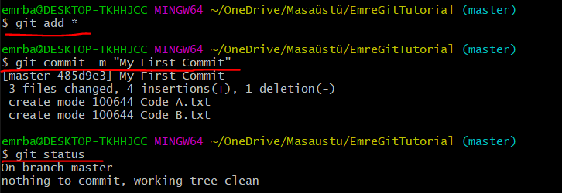
Let’s add them all again then commit to local repository
All the changes committed to the local repository and ready to push to the remote(GitHub) repository

Slide 28
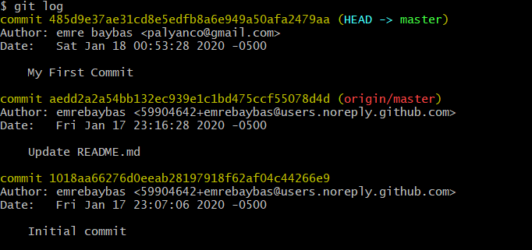
commit history
$ git log

Slide 29
Branches
There are two types of branching
Local branching
Remote-tracking branches
Git Bash always displays which branch you are working on
Main branch is called Master Branch
To list all the files in a branch $ ls

Slide 30
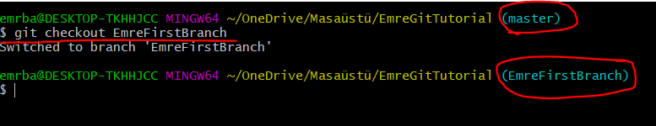
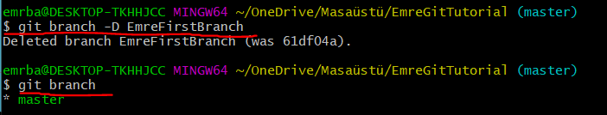
Creating a branch
$ git branch BranchName
Switch to a branch
$ git checkout BranchName
Deleting a branch
$ git branch -D BranchName

Slide 31
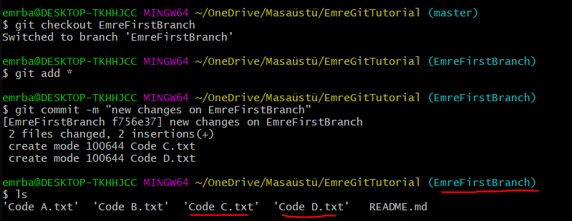
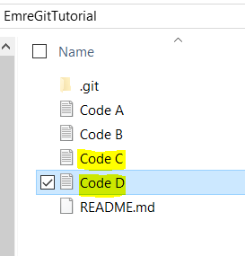
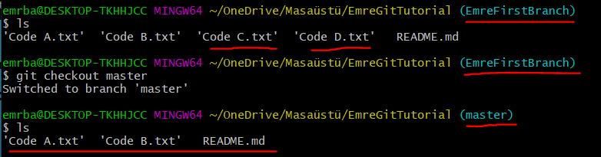
Now let’s go make some changes on this branch
These two new files were created on new branch
Now if we go back to master branch these two files wont be there

Slide 32
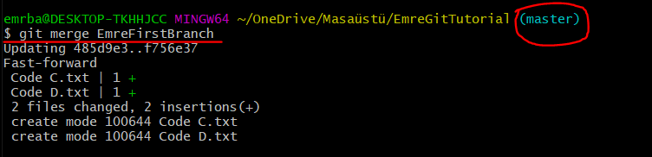
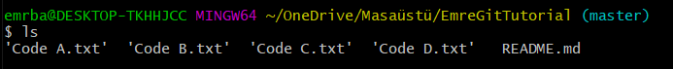
Merging a branch
$ git merge BranchName
Make sure to be on the master branch while merging
When you merge, files get automatically committed
After merging the EmreFirstBranch to Master. EmreFirstBranch still stays there, if you like to go back to it and do more changes you can.

Slide 33
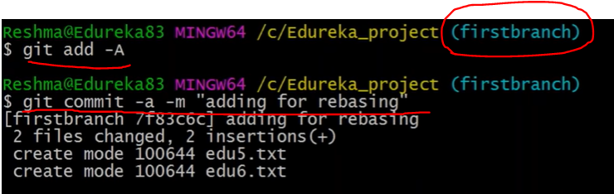
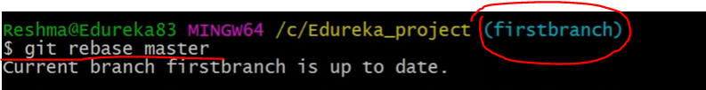
Rebasing a branch
Rebase is another form of merge that allows you to move all the branch commits to the master branch as they were committed on the master branch
Cleaner timeline of commits in linear workflow as all was done on master not on branches
First add all the files and commit before rebase
Rebase is done on branch ($ git rebase master) that’s why we rebased the changes from master to our branch
If we want to rebase changes on branch to the master, we need to be on the master branch and ($git rebase EmreFirstBranch) that way we put the changes on branch to the master

Slide 34
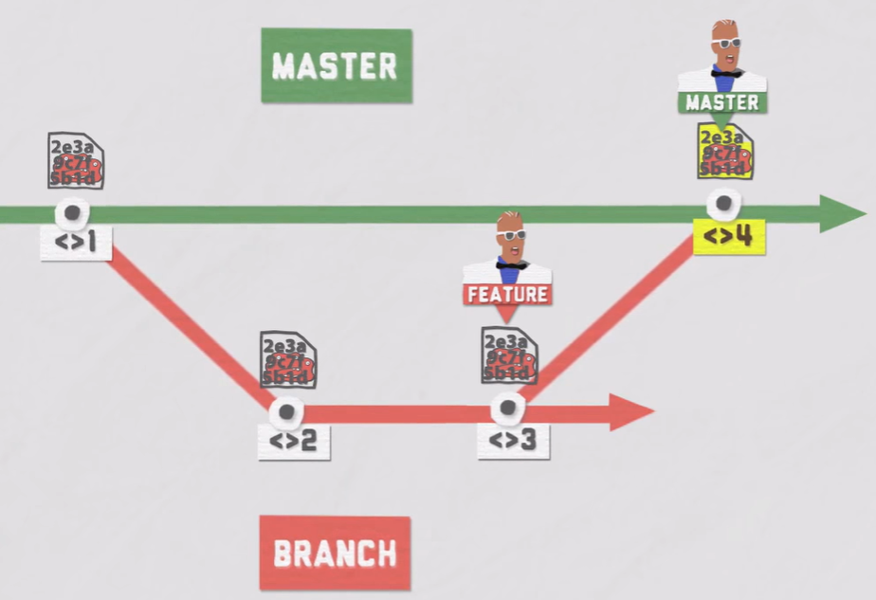
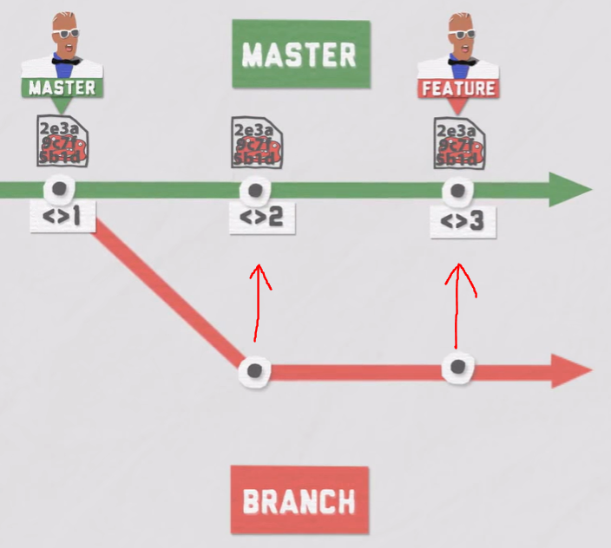
Difference between Merge and Rebase
Merge takes only the last commit which is #3 and puts it to the master branch
In the history, you would still branched development history
Rebase allows you to move all the branch commits to the master branch as they were committed on the master branch
Cleaner timeline of commits in linear workflow as all was done on master not on branches
Both merge and rebase will have the same final commit/snapshot
Only difference is rebase will give you cleaner timeline as everything was done on the master not on the branch
Merge is done on Master ($ git merge branch)
Rebase is done on master ($ git rebase branch)
Rebase also can be done on branch to bring latest changes in master to the branch. That would be on branch
and ($git rebase master)

Slide 35
About Rebase
Its not suggested to rebase if your are not authorized and 100% sure what you are doing since rebase changing the base as everything done on the master.
It may create conflict for other developers that are working on the same project
Merge is a safer way to go since not changing the baseline

Slide 36
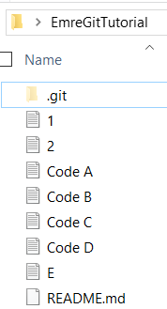
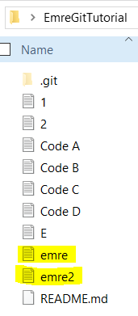
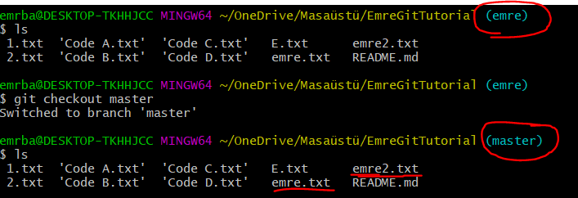
$ git stash
When you are working on a new branch
If you create a new file, it will be shown on master branch as well.
Even though, you created that file when you are on new branch before committing
Because before committing, that new file is not actually assigned to a specific branch. That’s why GIT will be reflecting those changes on all the branches available
Only after committing inside the new branch, your changes will be only shown in the new branch
We don’t want our changes shown in the master branch because it may create confusion for other people working on the master branch
But files also shown in master
Created new files on branch
There is two way to avoid this issue
1- As soon as we create a new file we commit it in the branch its created so that changes only will be shown in the new branch
2- We use $ git stash

Slide 37
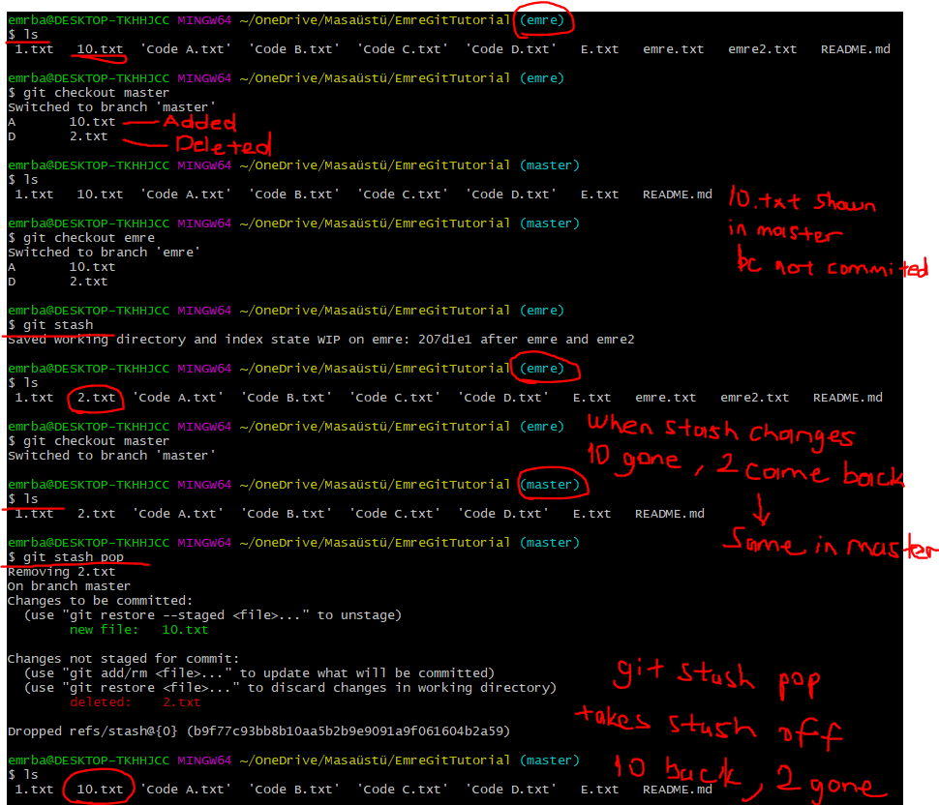
$ git stash $ git stash pop
We made some changes deleted 2.txt and added 10.txt on emre branch
Since we have not committed these changes, its also showing on the master branch
We can stash the changes to come back to it later so that it wont create confusion for other people working on the master branch

Slide 38
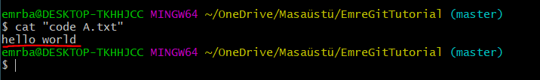
Displaying file details
$ cat FileName.txt
Will show you the text inside the file

Slide 39
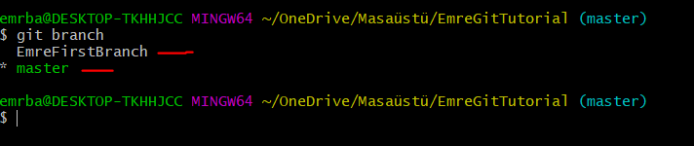
Displaying all the branches we have
$ git branch

Slide 40
Pushing to the github repository
As we work on two different branches, we are able to push them separately
So that in the public repository people would see the branch is what you are working on specifically other than the master baseline
We can push to the branch repository by $ git push origin EmreFirstBranch
Or We can push to the master repository by $ git push origin master

Slide 41
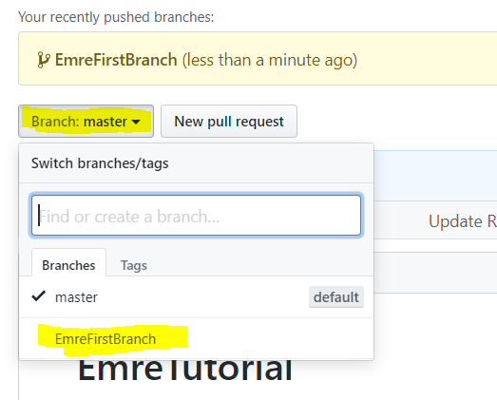



Pushing to the branch repository
As we can see master is not showing any of the created file because we did not push anything to master yet

Slide 42


Pushing to the master repository
Switch to master and $git push origin master

Slide 43



How to revert a file in your local repository
Lets change Code A from hello word to hello emre then add it to staging area and then commit it

Slide 44



How to revert a file in your local repository
Now we didn’t like the changes we did and we want to go back to the previous version of Code A.txt
Do not forget all these changes are being done in your local repository until you push them
This entire number is our commit hash. Lets just copy the first 8 digit of the hash for the previous commit we want our file to go back to.
$git checkout a3c8c82f “Code A.txt”
As we can see Code A.txt went back to “hello world” from “hello emre”

Slide 45
Reverting commit with $ git checkout in a new branch will remove it from master as well
If you revert to an older commit/version in new branch
It will also revert those changes in master branch as well
Let’s say in the new branch you created CodeX.txt and committed
Later on you decided that code file actually not good and wanted to remove it
You can use $ git checkout “commit hash” in the new branch
This will also remove the files from master branch as well

Slide 46

Git workflow

Slide 47
Git commands
$ git init [To initialize]
$ git remote add origin “URL” [To link your local repository with Github repository]
$ ls [To see the files in the local repository]
$ git add “filename” or git add * for all the files [To add files to staging area]
$ git commit –m “description of the commit” [To commit or save changes to local repo]
$ git status [ To view the status of file , modified, stages, created, untracked, committed]
$ git push origin brachname [To push the changes to the remote GitHub repository]
$ cat “filename” [To see what file contains]
$ git branch BranchName [To create a branch]
$ git branch -D BranchName [To delete a branch]
$ git branch [ To list all the branches]
$ git checkout BranchName [To switch between branches]
$ git log [To see the history of all the commits]

Slide 48
Git commands
$git checkout a3c8c82f “Code A.txt” [To revert the Code A.txt file to another commit version]
$ git checkout 3e1da053a42edad2c7952581b55da99f6c434c16 [To revert the entire commit to previous commit with this hash number]
$ git restore --staged “Code A.txt “ [To Unstage the files added]
$ git stash [To hide the changes done on the branch from showing in the master before commit]
$ git stash pop [To bring back the changes that was stashed]
$ nano filename [To create a file inside the git bash terminal]
$ git rm filename [To delete a file inside the git bash terminal]
$ git config --global core.safecrlf false [To turn of the LF→CRLF warning whe you create a file by nano filename]

Slide 49


Create and delete a file in git bash terminal
$ nano filename such as 2.txt
$ nano 2.txt
$ git rm 2.txt
You can only delete files that are committed
Ctrl + X to save and go back to git terminal
After deleting make sure to commit so that it will be saved without the deleted file.

Slide 50



$ git clone “URL“
‘$ git clone’ is used to clone/download your or someone else's repository from GITHUB to your local machine.
Lets go ahead and create a new working directory and see how we can clone a directory from remote repository

Slide 51

$ git clone “URL“
As you can see our new working directory “clone purposes” folder now has cloned EmreTutoriol folder with the files inside
Also when you clone a directory and after making some changes if you push it “ $ git push origin master” it will push it to where it was pulled from.

Slide 52
Difference between Git pull and git clone
$git clone is when you want to copy the whole repository on GITHUB to your local machine
$git pull is when you already have the files and you want to update your files in your local repository from the latest commit on the GITHUB repository

Slide 53
Difference between git pull and git fetch
$git pull = $git fetch + $git merge
Git fetch pull all the files from Github repository and places them in a new branch so if you want see them on your master you need to merge
Git pull pulls all the files and places on master branch

Slide 54
Checkout:
Use this to move the HEAD pointer to a specific commit or switch between branches.
It rollbacks any content changes to those of the specific commit.
This will not make changes to the commit history.
Has potential to overwrite files in the working directory.
Revert:
Rollback changes you have committed.
Creates a new commit from a specified commit by inverting it. Hence, adds a new commit history to the project, but it does not modify the existing one.
Has the potential to overwrite files in the working directory.
Reset:
Use this to return the entire working tree to the last committed state. This will discard commits in a private branch or throw away uncommitted changes!
Changes which commit a branch HEAD is currently pointing at. It alters the existing commit history.
Can be used to unstage a file.

Slide 55


$ git diff commit hash_1 commit hash_2
$ git diff command will show the what changes have been done between these commits

Slide 56

$ git diff head .
head stands for the last commit version
. Stands for the current version (after you make some changes but not committed yet)
Basically $ git diff head . Shows what you have change after the last commit before the new commit you will make

Slide 57
Git ignore

